Slide 1
Problem Definition
The company is experiencing high employee attrition, which is impacting productivity and increasing recruitment costs.
Certain departments, such as Finance and HR, show higher attrition rates compared to others.
Employee engagement, career growth, and work-life balance are key factors affecting retention.
Location-specific challenges are contributing to inconsistent attrition patterns across cities.
Lack of actionable insights is delaying management’s response to workforce issues.

Slide 2
Data Insights
40% of employees have left the organization.
Sales has the highest attrition rate at 54.55%, which is a major concern.
Operations, HR, and Marketing have moderate attrition.
Delhi (45%) and Hyderabad (43.75%) are struggling with higher attrition.
Mumbai (25%) is doing relatively better and could be a model to study.
Tenure has a strong negative correlation (-0.894) with attrition → employees with longer tenure are less likely to leave.
Engagement Score shows a small positive correlation (0.0787) → better engagement slightly helps retention.

Slide 3
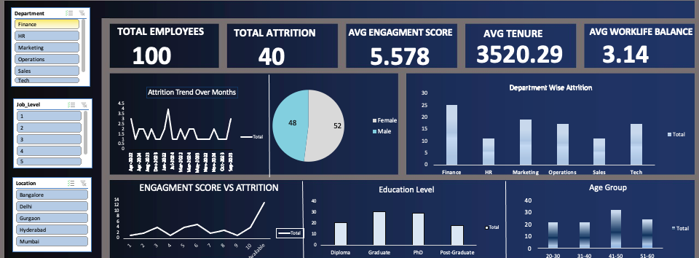
Dashboard Snapshots

Slide 4
Recommendations
Organize regular feedback sessions, wellness activities, and training opportunities to boost morale.
Offer flexible working hours, remote work options, and mental health support.
Develop location-specific policies as attrition rates vary between cities like Delhi, Bangalore, and Mumbai.
Continuously track engagement scores, tenure, and performance to predict attrition.
Monitor and manage workload distribution.

Slide 5
Implementation Plan
Month 1:
Collect feedback from employees via surveys.
Identify high-risk groups and departments.
Month 2:
Launch mentoring, training, and wellness programs.
Introduce flexible schedules for work-life balance.
Month 3:
Monitor progress using dashboards.
Analyze data and adjust strategies based on trends.

